Slide 1

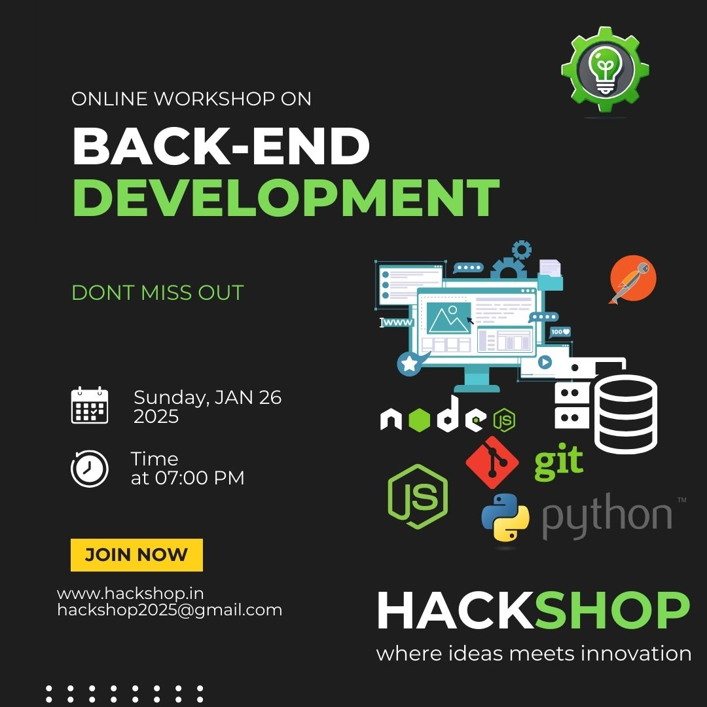
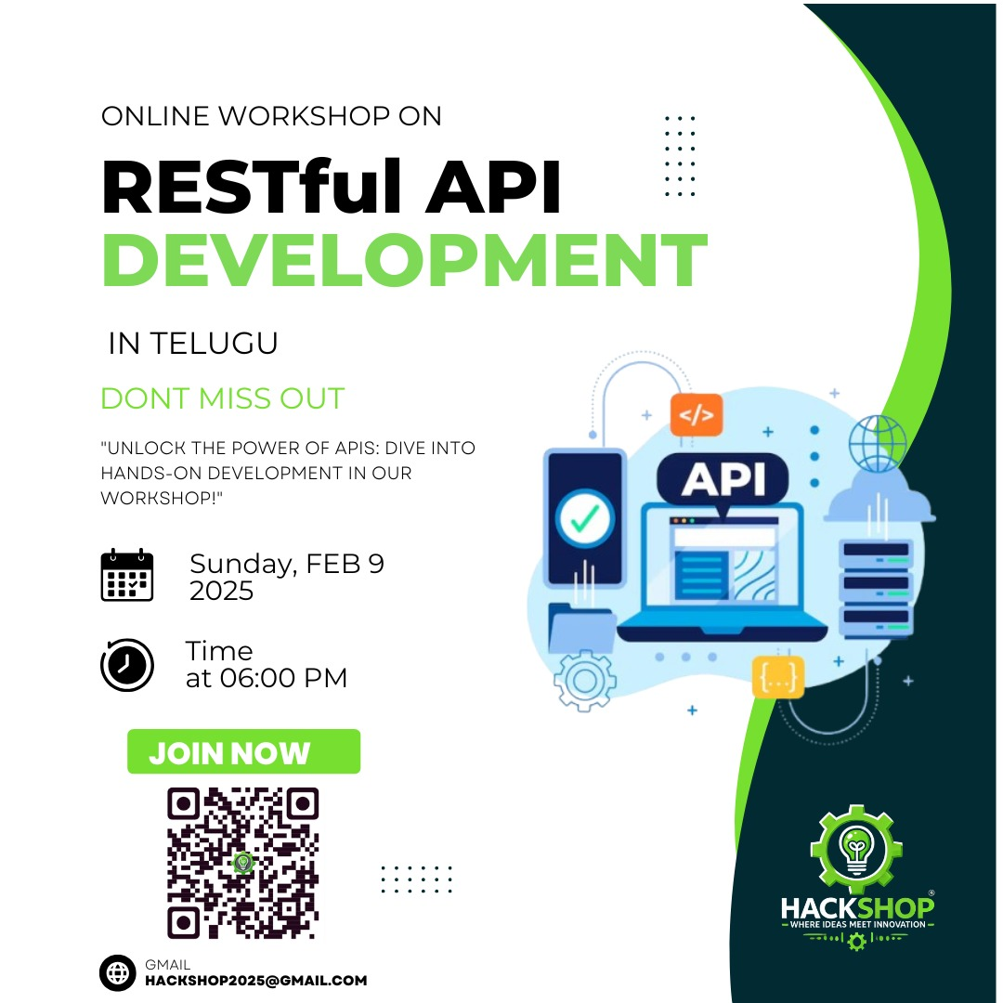
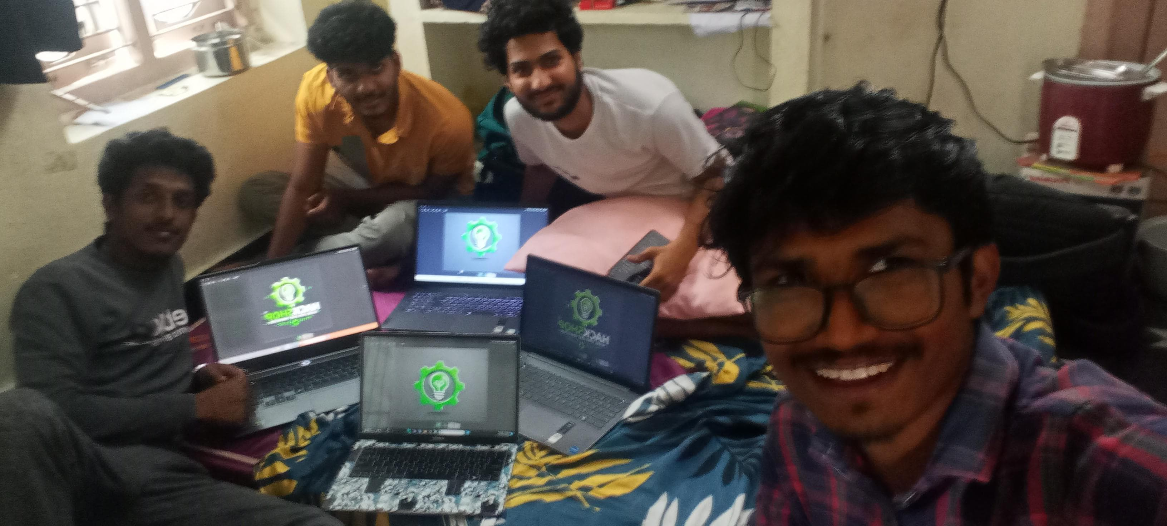
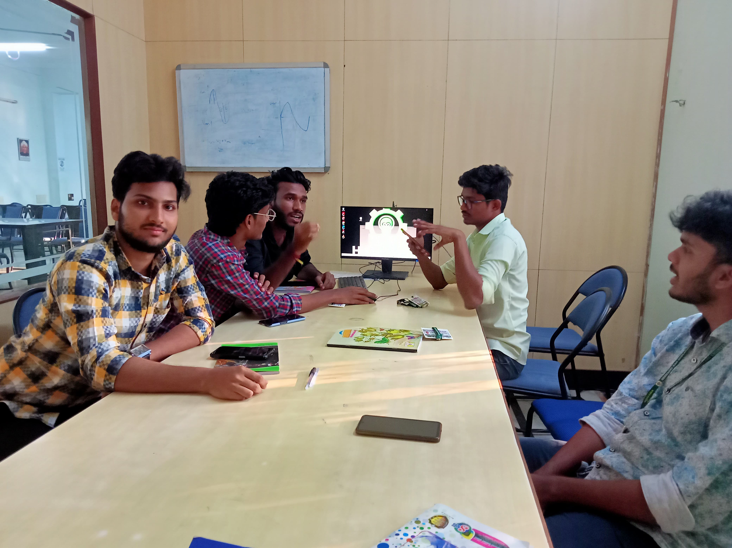
STARTUP OVERVIEW
  Hackshop : where ideas meet innovaton
Sector : Edtech,skill development
Startup Type: service-based
Year of Establishment: 2025
Startup Founder:
M N V V AJAY KUMAR
In today's fast-evolving world, students often struggle to gain real-world experience, practical skills, and entrepreneurial exposure beyond traditional academics. Many talented individuals lack access to hands-on learning opportunities, industry connections, and platforms to showcase their innovative ideas. Additionally, there is a gap between theoretical education and the skills required by modern industries, making it difficult for students to transition into successful careers or start their own ventures
PROBLEM ADDRESSED:
MENTORS NAME/S
TECHNOLOGY READINESS LEVEL (TRL)
INTELLECTUAL PROPERTY
Dr. B. Mahesh Babu
TRL: TRL 7-8
The core business model of conducting hackathons, workshops, and entrepreneurship events is well-established and actively operating with successful implementations
INSTITUTION NAME
Seshadri Rao Gudlavalleru Engineering College
BUSINESS DETAILS
SERVICES IMAGE
Brief Description: Hackshop is a dynamic platform that organizes hackathons, ideathons, workshops, and creative events for students. It aims to bridge the gap between theoretical knowledge and real-world skills by providing hands-on experience through competitions and industry collaborations
.Products/Services Offered: Event Management, Skill Development
Target Market: Students, colleges, startups, and industry professionals (National & Global)
Revenue Model: Event-based sponsorships, registration fees, partnerships with educational institutions, and premium learning experiences
Current Status:
Fig.1 sample workshops on backend and RestFULL API development
SPECIAL FEATURES & INNOVATIONS
Unique Selling Proposition (USP): global event cultures, making it a one-of-a-kind learning experience
Technological Innovations:
Sustainability & Impact:
PROGRESSION OF THE BUSINESS
Key Milestones:
2025: Established Hackshop and conducted Workshops
Partnered with multiple communitys for student-driven events
END USERS/CUSTOMERS
CONTACT DETAILS
Students, colleges, startups, and industry professionals
Website/Social Media: https://youtube.com/@hackshop2025?si=nlJ3WC4W8MyOeIFk
Email: hackshop2025@gmail.com Phone: 8919844106
SUCCESS STORY
Challenges Faced: Initial struggle in gaining outreach and sponsorships.
Breakthrough Moment: First successful event with significant student participation.
Achievements & Recognition: Growing community, collaborations with institutions, and increasing student engagement.
Future Vision: Expanding globally, introducing AI-driven event management, and fostering more student startups
tbi@kiitincubator.in
Web link: https://gecgudlavalleru.ac.in/iic.php

